Slide 1
Orthogonality and Least Squares
THE GRAM-SCHMIDT PROCESS

Slide 2
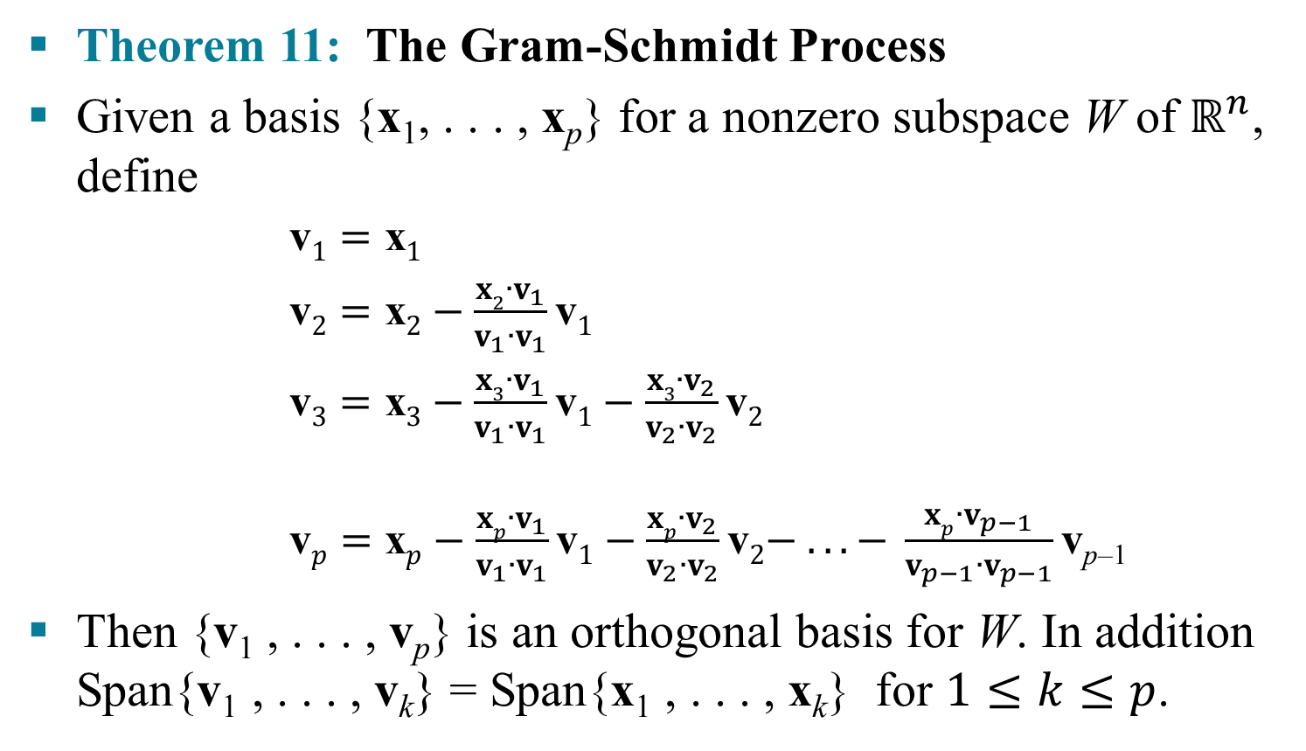
THE GRAM-SCHMIDT PROCESS
Theorem 11: The Gram-Schmidt Process
Given a basis {x₁, . . . , x_{p}} for a nonzero subspace W of $ℝ^{n}$, define
$\text{v}1=\text{x}1$
$\text{v}2=\text{x}2−\frac{x2∙v_{1}}{v_{1}{∙v}_{1}}\text{v}1$
$\text{v}3=\text{x}3−\frac{x3∙v_{1}}{v_{1}{∙v}_{1}}\text{v}1−\frac{x3∙v_{2}}{v_{2}{∙v}_{2}}\text{v}2$
$\text{v}p=\text{x}p−\frac{xp∙v_{1}}{v_{1}{∙v}_{1}}\text{v}1−\frac{xp∙v_{2}}{v_{2}{∙v}_{2}}\text{v}2− . . . − \frac{xp∙v_{p−1}}{v_{p−1}{∙v}_{p−1}}\text{v}$_{p–1}
Then {v₁ , . . . , v_{p}} is an orthogonal basis for W. In addition Span{v₁ , . . . , v_{k}} = Span{x₁ , . . . , x_{k}} for $1≤k≤p$.
.
.
.
(1)

Slide 3
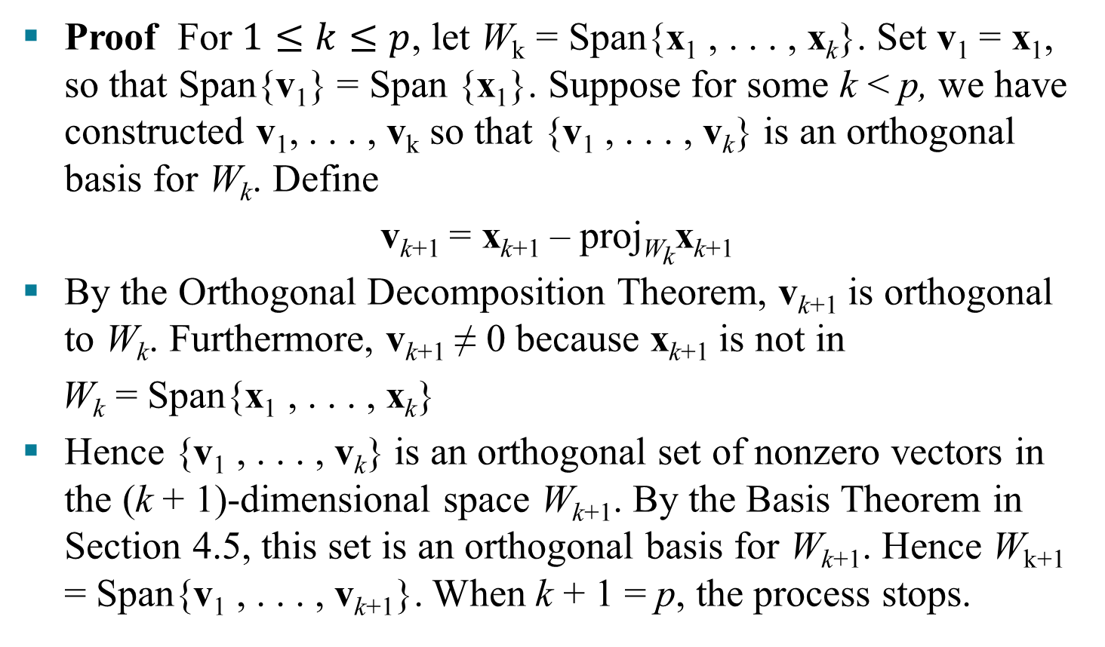
THE GRAM-SCHMIDT PROCESS
Proof For $1≤k≤p$, let W_{k} = Span{x₁ , . . . , x_{k}}. Set v₁ = x₁, so that Span{v₁} = Span {x₁}. Suppose for some k < p, we have constructed v₁, . . . , v_{k} so that {v₁ , . . . , v_{k}} is an orthogonal basis for W_{k}. Define
v_{k+1} = x_{k+1} – proj_{Wk}x_{k+1}
By the Orthogonal Decomposition Theorem, v_{k+1} is orthogonal to W_{k}. Furthermore, v_{k+1} ≠ 0 because x_{k+1} is not in
W_{k} = Span{x₁ , . . . , x_{k}}
Hence {v₁ , . . . , v_{k}} is an orthogonal set of nonzero vectors in the (k + 1)-dimensional space W_{k+1}. By the Basis Theorem in Section 4.5, this set is an orthogonal basis for W_{k+1}. Hence W_{k+1} = Span{v₁ , . . . , v_{k+1}}. When k + 1 = p, the process stops.
(2)

Slide 4
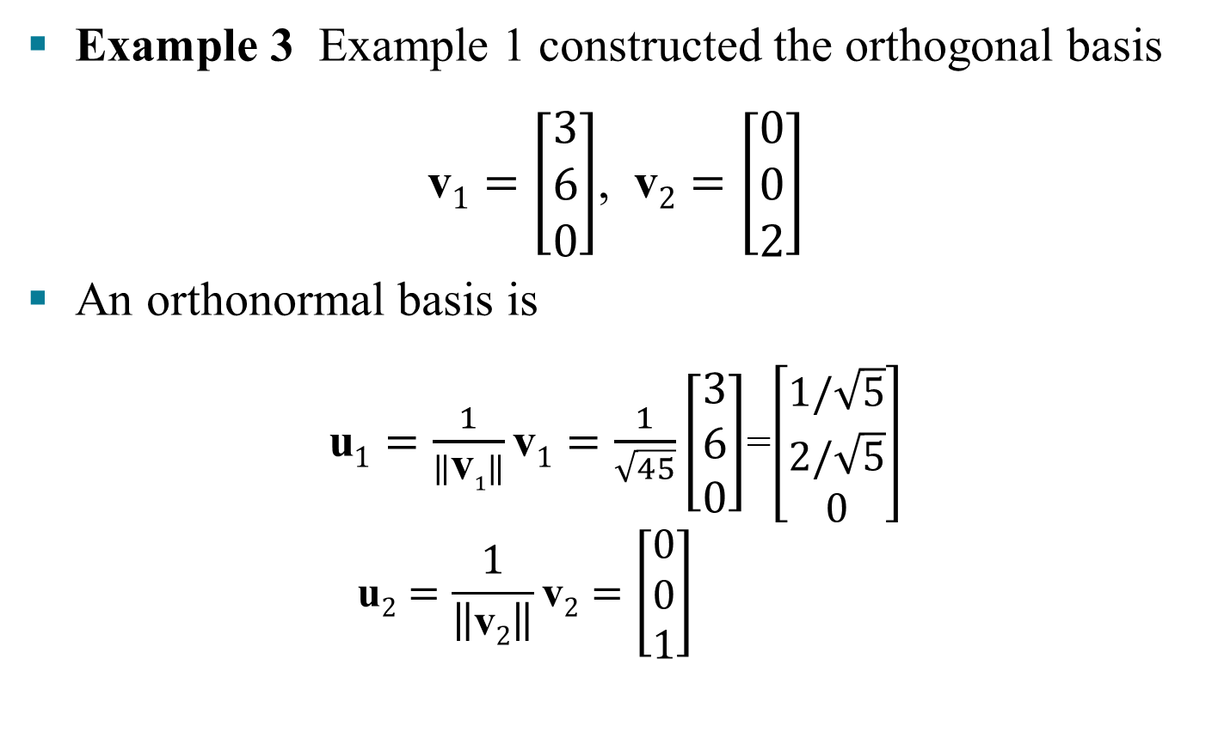
ORTHONORMAL BASES
Example 3 Example 1 constructed the orthogonal basis
$\text{v}1=\left[\begin{aligned}3 \\ 6 \\ 0\end{aligned}\right]$, $\text{v}2=\left[\begin{aligned}0 \\ 0 \\ 2\end{aligned}\right]$
An orthonormal basis is
$\text{u}1=\frac{1}{\left\|\text{v}1\right\|}\text{v}1=\frac{1}{\sqrt{45}}\left[\begin{aligned}3 \\ 6 \\ 0\end{aligned}\right]$=$\left[\begin{aligned}1/\sqrt{5} \\ 2/\sqrt{5} \\ 0\end{aligned}\right]$
$$\text{u}2=\frac{1}{\left\|\text{v}2\right\|}\text{v}2=\left[\begin{aligned}0 \\ 0 \\ 1\end{aligned}\right]$$

Slide 5
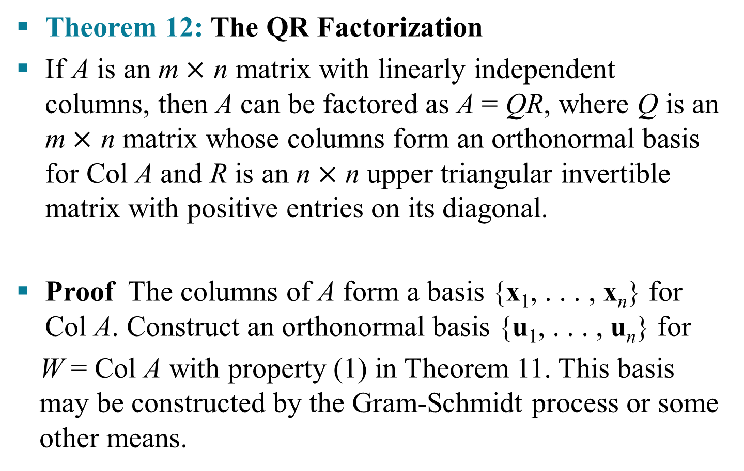
QR FACTORIZATION OF MATRICES
Theorem 12: The QR Factorization
If A is an m$×$ n matrix with linearly independent columns, then A can be factored as A = QR, where Q is an m$×$ n matrix whose columns form an orthonormal basis for Col A and R is an n$×$ n upper triangular invertible matrix with positive entries on its diagonal.
Proof The columns of A form a basis {x₁, . . . , x_{n}} for Col A. Construct an orthonormal basis {u₁, . . . , u_{n}} for
W = Col A with property (1) in Theorem 11. This basis may be constructed by the Gram-Schmidt process or some other means.

Slide 6
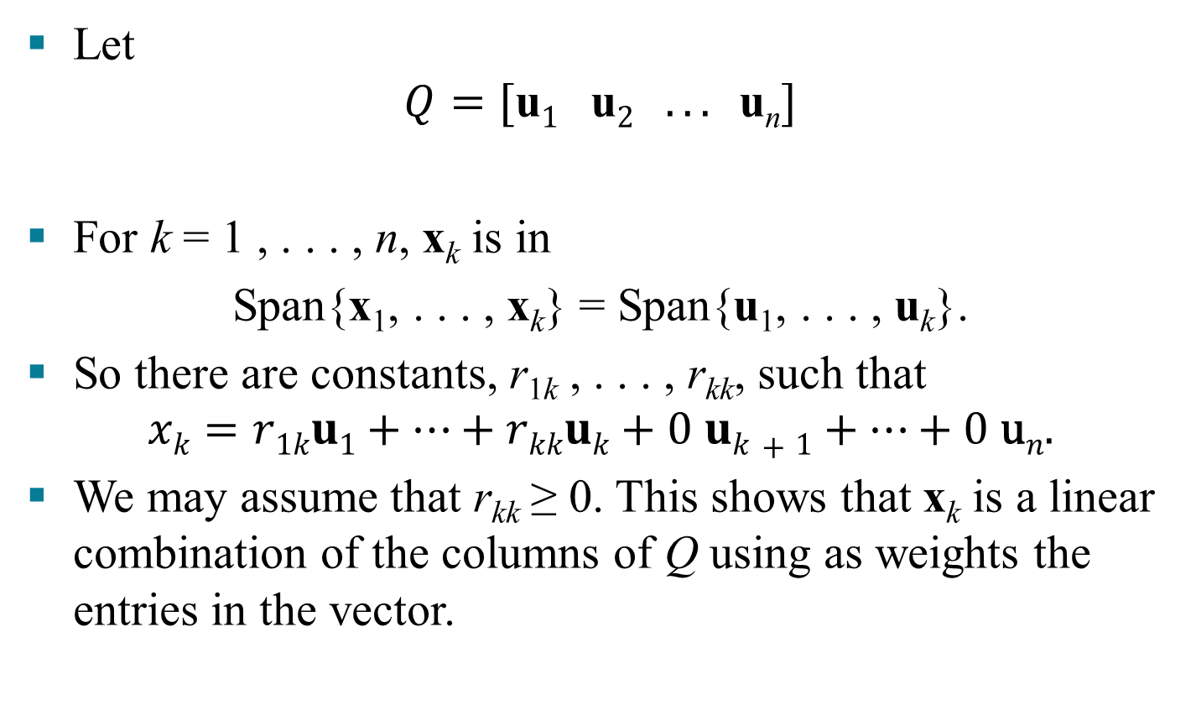
QR FACTORIZATION OF MATRICES
Let
$$Q=[\text{u}1 \text{u}2 . . . \text{u}\text{n}]$$
For k = 1 , . . . , n, x_{k} is in
Span{x₁, . . . , x_{k}} = Span{u₁, . . . , u_{k}}.
So there are constants, r_{1k} , . . . , r_{kk}, such that
$$xk=r1ku1+…+rkkuk+0 uk+1+…+0 \text{u}n.$$
We may assume that r_{kk} ≥ 0. This shows that x_{k} is a linear combination of the columns of Q using as weights the entries in the vector.

Slide 7
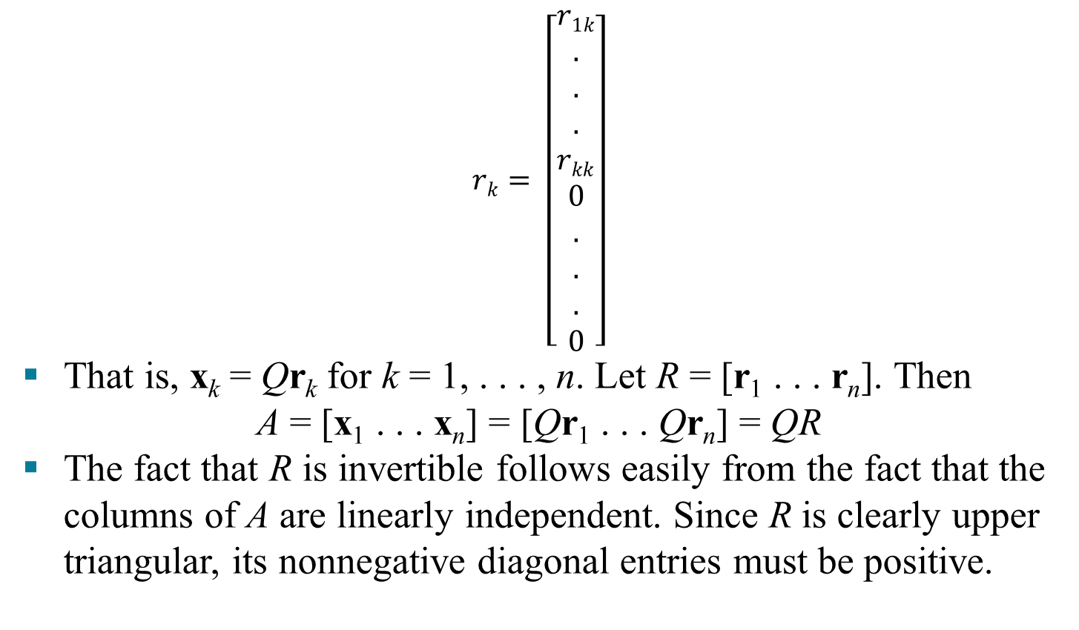
QR FACTORIZATION OF MATRICES
$$rk= \left[\begin{aligned}r1k \\ . \\ . \\ . \\ rkk \\ 0 \\ . \\ . \\ . \\ 0\end{aligned}\right]$$
That is, x_{k} = Qr_{k} for k = 1, . . . , n. Let R = [r₁ . . . r_{n}]. Then
A = [x₁ . . . x_{n}] = [Qr₁ . . . Qr_{n}] = QR
The fact that R is invertible follows easily from the fact that the columns of A are linearly independent. Since R is clearly upper triangular, its nonnegative diagonal entries must be positive.

Slide 8
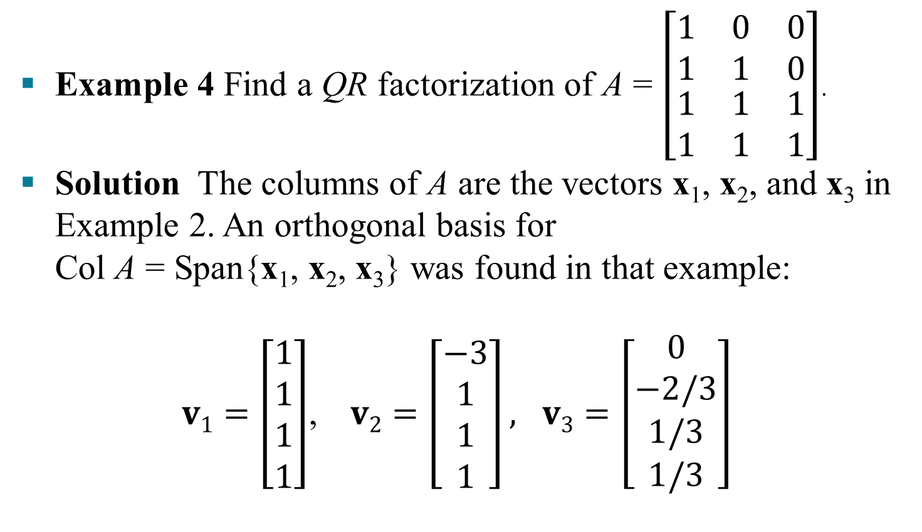
QR FACTORIZATION OF MATRICES
Example 4 Find a QR factorization of A = $\left[\begin{matrix}1 & 0 & 0 \\ 1 & 1 & 0 \\ \begin{aligned}1 \\ 1\end{aligned} & \begin{aligned}1 \\ 1\end{aligned} & \begin{aligned}1 \\ 1\end{aligned}\end{matrix}\right]$.
Solution The columns of A are the vectors x₁, x₂, and x₃ in Example 2. An orthogonal basis for Col A = Span{x₁, x₂, x₃} was found in that example:
$v1=\left[\begin{aligned}1 \\ 1 \\ 1 \\ 1\end{aligned}\right]$, $v2=\left[\begin{aligned}−3 \\ 1 \\ 1 \\ 1\end{aligned}\right], v3=\left[\begin{aligned}0 \\ −2/3 \\ 1/3 \\ 1/3\end{aligned}\right]$

Slide 9
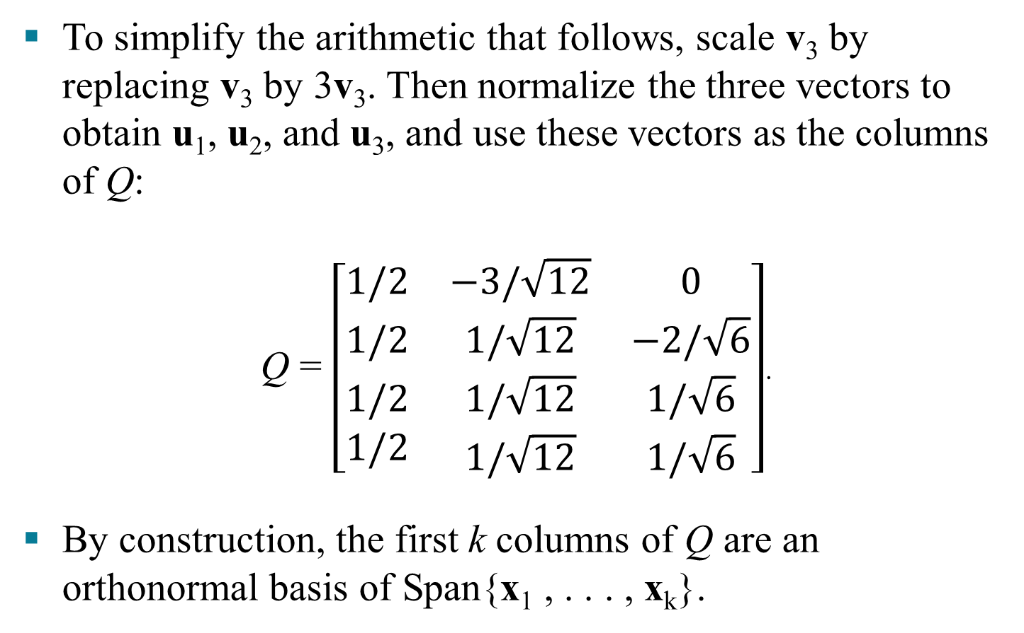
QR FACTORIZATION OF MATRICES
To simplify the arithmetic that follows, scale v₃ by replacing v₃ by 3v₃. Then normalize the three vectors to obtain u₁, u₂, and u₃, and use these vectors as the columns of Q:
Q = $\left[\begin{matrix}1/2 & −3/\sqrt{12} & 0 \\ 1/2 & 1/\sqrt{12} & −2/\sqrt{6} \\ \begin{aligned}1/2 \\ 1/2\end{aligned} & \begin{aligned}1/\sqrt{12} \\ 1/\sqrt{12}\end{aligned} & \begin{aligned}1/\sqrt{6} \\ 1/\sqrt{6}\end{aligned}\end{matrix}\right]$.
By construction, the first k columns of Q are an orthonormal basis of Span{x₁ , . . . , x_{k}}.

Slide 10
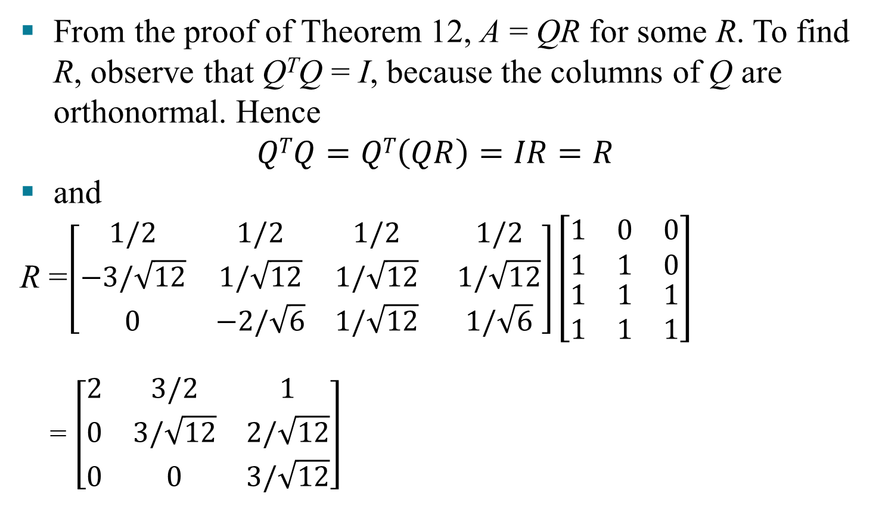
QR FACTORIZATION OF MATRICES
From the proof of Theorem 12, A = QR for some R. To find R, observe that Q^{T}Q = I, because the columns of Q are orthonormal. Hence
$$QTQ=QT\left(QR\right)=IR=R$$
and
R =$\left[\begin{matrix}1/2 & 1/2 & 1/2 \\ −3/\sqrt{12} & 1/\sqrt{12} & 1/\sqrt{12} \\ 0 & −2/\sqrt{6} & 1/\sqrt{12}\end{matrix} \begin{matrix}1/2 \\ 1/\sqrt{12} \\ 1/\sqrt{6}\end{matrix}\right]\left[\begin{matrix}1 & 0 & 0 \\ 1 & 1 & 0 \\ \begin{aligned}1 \\ 1\end{aligned} & \begin{aligned}1 \\ 1\end{aligned} & \begin{aligned}1 \\ 1\end{aligned}\end{matrix}\right]$
= $\left[\begin{matrix}2 & 3/2 & 1 \\ 0 & 3/\sqrt{12} & 2/\sqrt{12} \\ 0 & 0 & 3/\sqrt{12}\end{matrix}\right]$

